Slide 1
Machine Learning cREDIT CARD APPROVAL PREDICTION

Slide 2
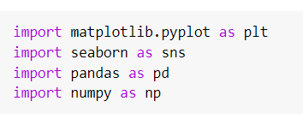
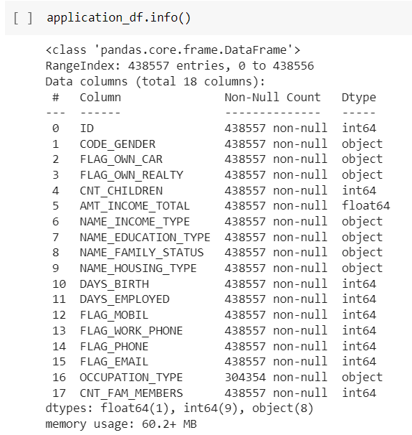
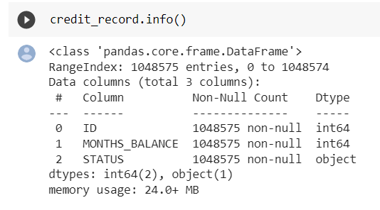
Importing required libraries:
Pre-processing of the data:
Gathering information about the datasets:
We analysis the data to find whether the datasets contains any null values.

Slide 3
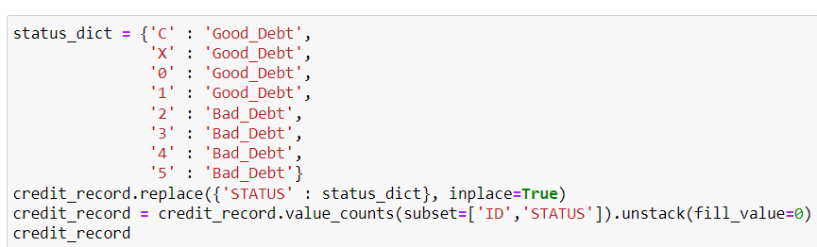
Pre-processing of the data:
Good Debt, Bad Debt:
We introduced a new criteria here to see whether the person has a Good Debt or a Bad Debt.
It was not mentioned what to consider as a Good Debt and what to consider Bad Debt so we consider that if the person paid his or her debt before due date or after due date as Good Debt and everything else as Bad Debt.
CREDIT_APPROVAL_STATUS:
To decide whether the person gets credit card, we introduced two condition for it as if the Good Debt is greater than Bad Debt then the person will get the approval, if the Good Debt is less than or equal to Bad Debt then the person will get the approval.

Slide 4
Pre-processing of the data:
Merging of the Dataframes:
After analysis of the data and defining the meaning of the column CREDIT_APPROVAL_STATUS we now merge the datasets 'ID' wise.
Dealing with the negative values:
Converting the values to column DAYS_BIRTH & DAYS_EMPLOYED from negative to positive. Then converting from days to years for visualization
Segregating numerical & categorical variables:
We perform this so that we can apply Imputer Class with different strategy on numerical variable/s and different strategy on categorical variable/s.

Slide 5
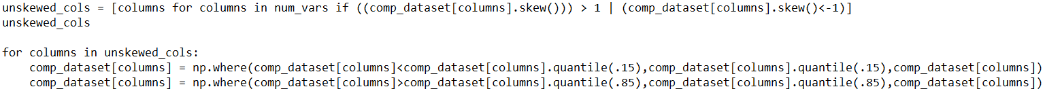
Pre-processing of the data:
Detection of Outliers:
An outlier is an observation that lies in an abnormal distance from other values in random sample of population. Some the outliers can be understood from the output.
The .skew() helps us calculate the skewness of the column
Value calculated should be between –1 to 1.
If not the column consists of outliers.
Separation of Labels and Features from Dataframe:
Before feeding the dataframe to the model the labels and feature are to be separated. In our case the CREDIT_APPROVAL_STATUS is the column of Label and rest are features.

Slide 6
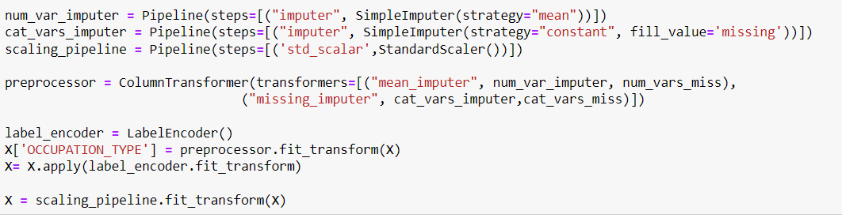
Creating a pipeline:
Python scikit-learn utility for orchestrating machine learning operations
Pipelines function by allowing a linear series of data transforms to be linked together, resulting in a measurable modelling process.
The pipeline in our case helped us perform:
Impute
StandardScaling

Slide 7
Splitting the dataset into Training and Test set
Importing the train_test_split from model selection of the sklearn module.
Test_size: It is used to determine the amount of data that will be present in the train and test set. Here 0.3 means the data is divided into 70 : 30 ratio.
Random_state: It controls the shuffling applied to the data before applying the split.

Slide 8
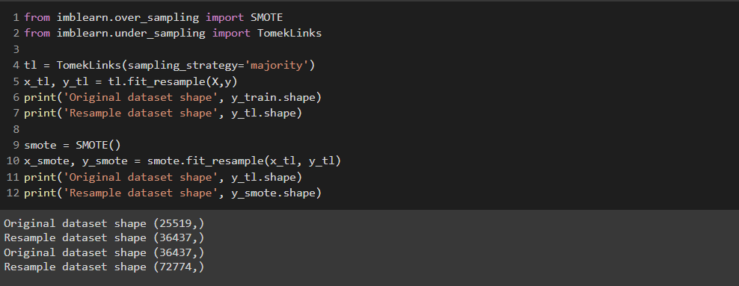
Performing over sampling and under sampling

Slide 9
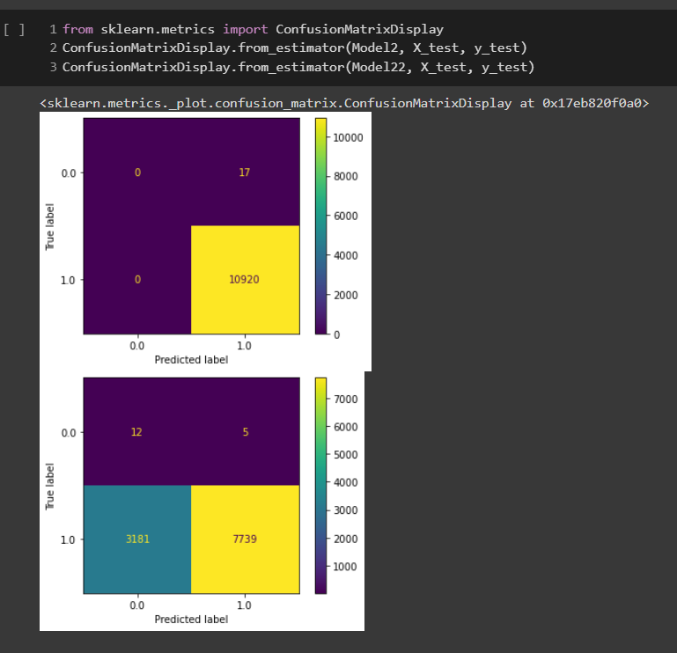
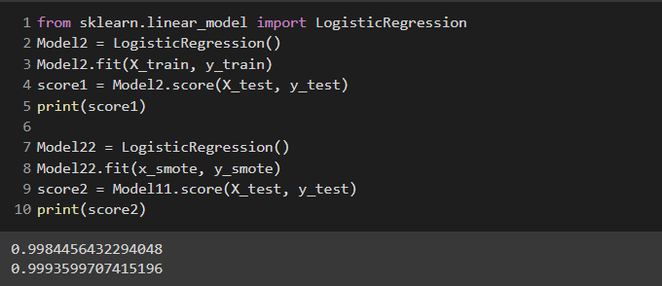
Logistic Regression

Slide 10
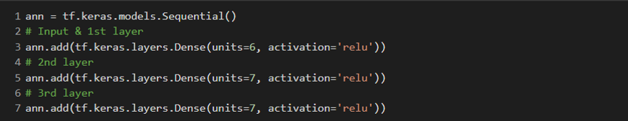
Artificial Neural Network
Importing all the Libraries:
Adding the Input/first layer and the hidden layers:
Adding the output layer:
Compiling and Training the ANN on the Training set:

Slide 11
THANK YOU

